Slide 1
Pokerbots 2023
Matt, Sophie, Haijia, Gabe, Max, Dylan, Gaurab, Alex
Notes:
Shreyas
---

Slide 2
What is Pokerbots?
Notes:
Shreyas
---

Slide 3
Pokerbots consists of a four week class and competition over the course of IAP.
Jan 9
Jan 20
Feb 3
First Class
Last Class
Tournament
Intro to bot building!
(Getting started)
Advanced strategy!
(Likely ML-based)
Prizes!!!
Sponsor networking!
Throughout: mini-tournaments, mini-games, and raffles (a.k.a. more prizes!!)
New for 2023: potential guest lectures, poker night(s)
Notes:
Shreyas
---
Pokerbots is an IAP class and competition.
6 classes over the first two weeks of IAP, starting with intro to bot building, leading to more computer science topics and poker strategy/game theory lectures, and culminating with an advanced strategy lecture.
Final tournament at the end of IAP.

Slide 4
Why Pokerbots?
Notes:
Gabe
---

Slide 5
Founded in project-based learning, Pokerbots provides the perfect opportunity for a variety of goals.
Coding, Git, software design, iterative engineering
Practical Skills
Project-Based Learning
Applying Theory
Personal Growth
Math, computer science, game theory, statistics
Teamwork, trying something new, healthy competition
Notes:
Gabe
---

Slide 6
$40,000+
Total Prize Pool for IAP 2023
Notes:
Gabe
---

Slide 7












Sponsored by multiple top quantitative finance firms, Pokerbots is also a great opportunity for networking and landing jobs or internships!
pkr.bot/drop
Notes:
Shreyas
---

Slide 8
How do I do Pokerbots?
Notes:
Stephen
---

Slide 9
Throughout IAP we offer a variety of resources to help you along the bot-building process.
Starting Points
Reference bots in Python, Java, C++
Scrimmage Server
Academic Papers
Resources
Lectures
Daily Office Hours
Piazza
Teammates!
Notes:
Stephen
---
Mention skeleton bots

Slide 10
How do I sign up?
Pre-Register (soon!)
pkr.bot/register
Play Blotto
pkr.bot/blotto
Play LUPI
pkr.bot/lupi
Notes:
Stephen
---

Slide 11

Blotto + LUPI Challenges
pkr.bot/blotto
Notes:
Stephen
---
1st place: AirPod Maxs
2nd - 5th place: Beats Buds

Slide 12
Blotto + LUPI Challenges
pkr.bot/lupi
LUPI: Lowest Unique Positive Integer
Rules: in the name
Submit 1 number for a chance at AirPods Pro’s!
Notes:
Andy
---

Slide 13
Blotto + LUPI Challenges
pkr.bot
Blotto Day!
Wed 12/14, 7-8pm EST
Room: 2-105
Notes:
Andy
---

Slide 14
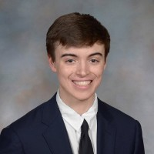
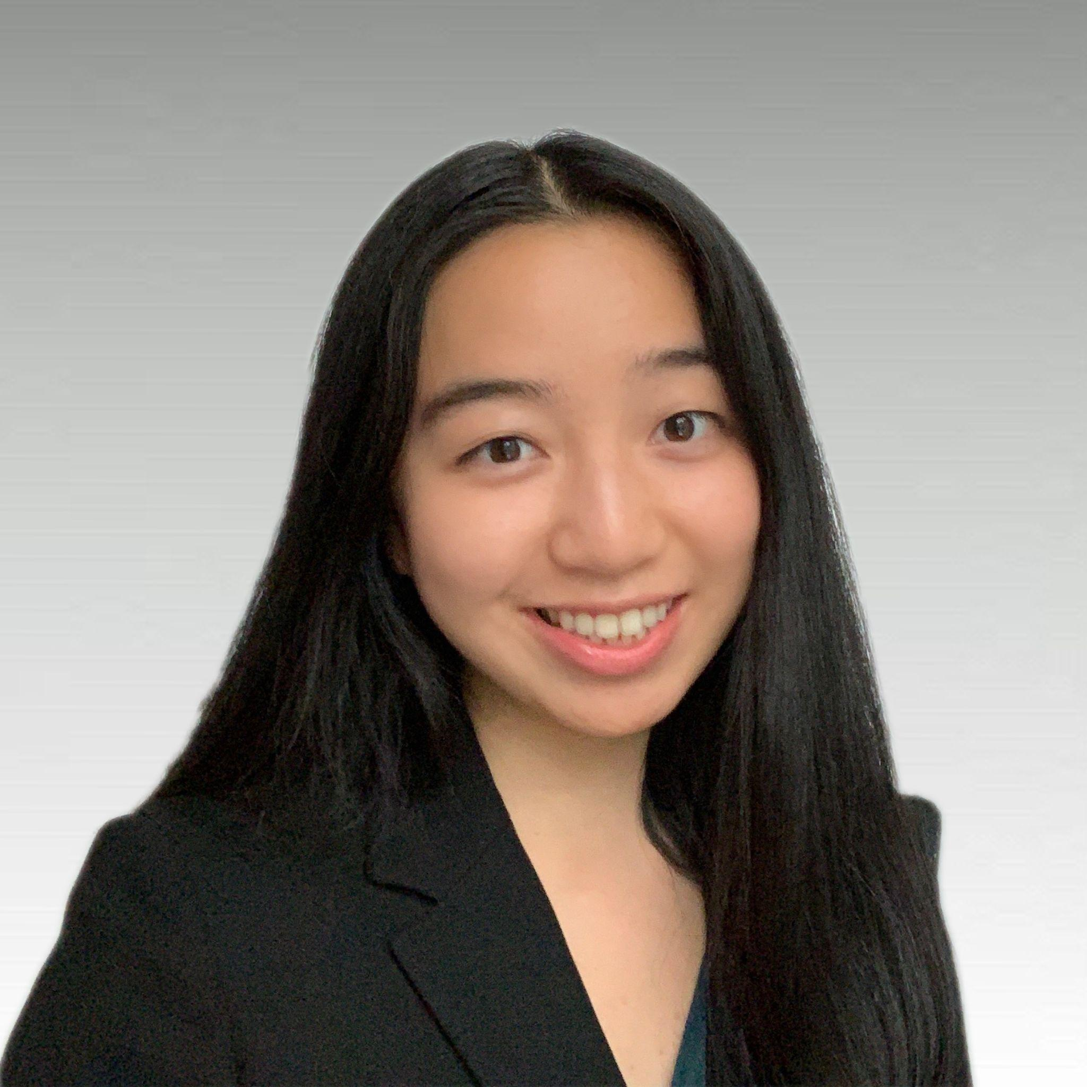
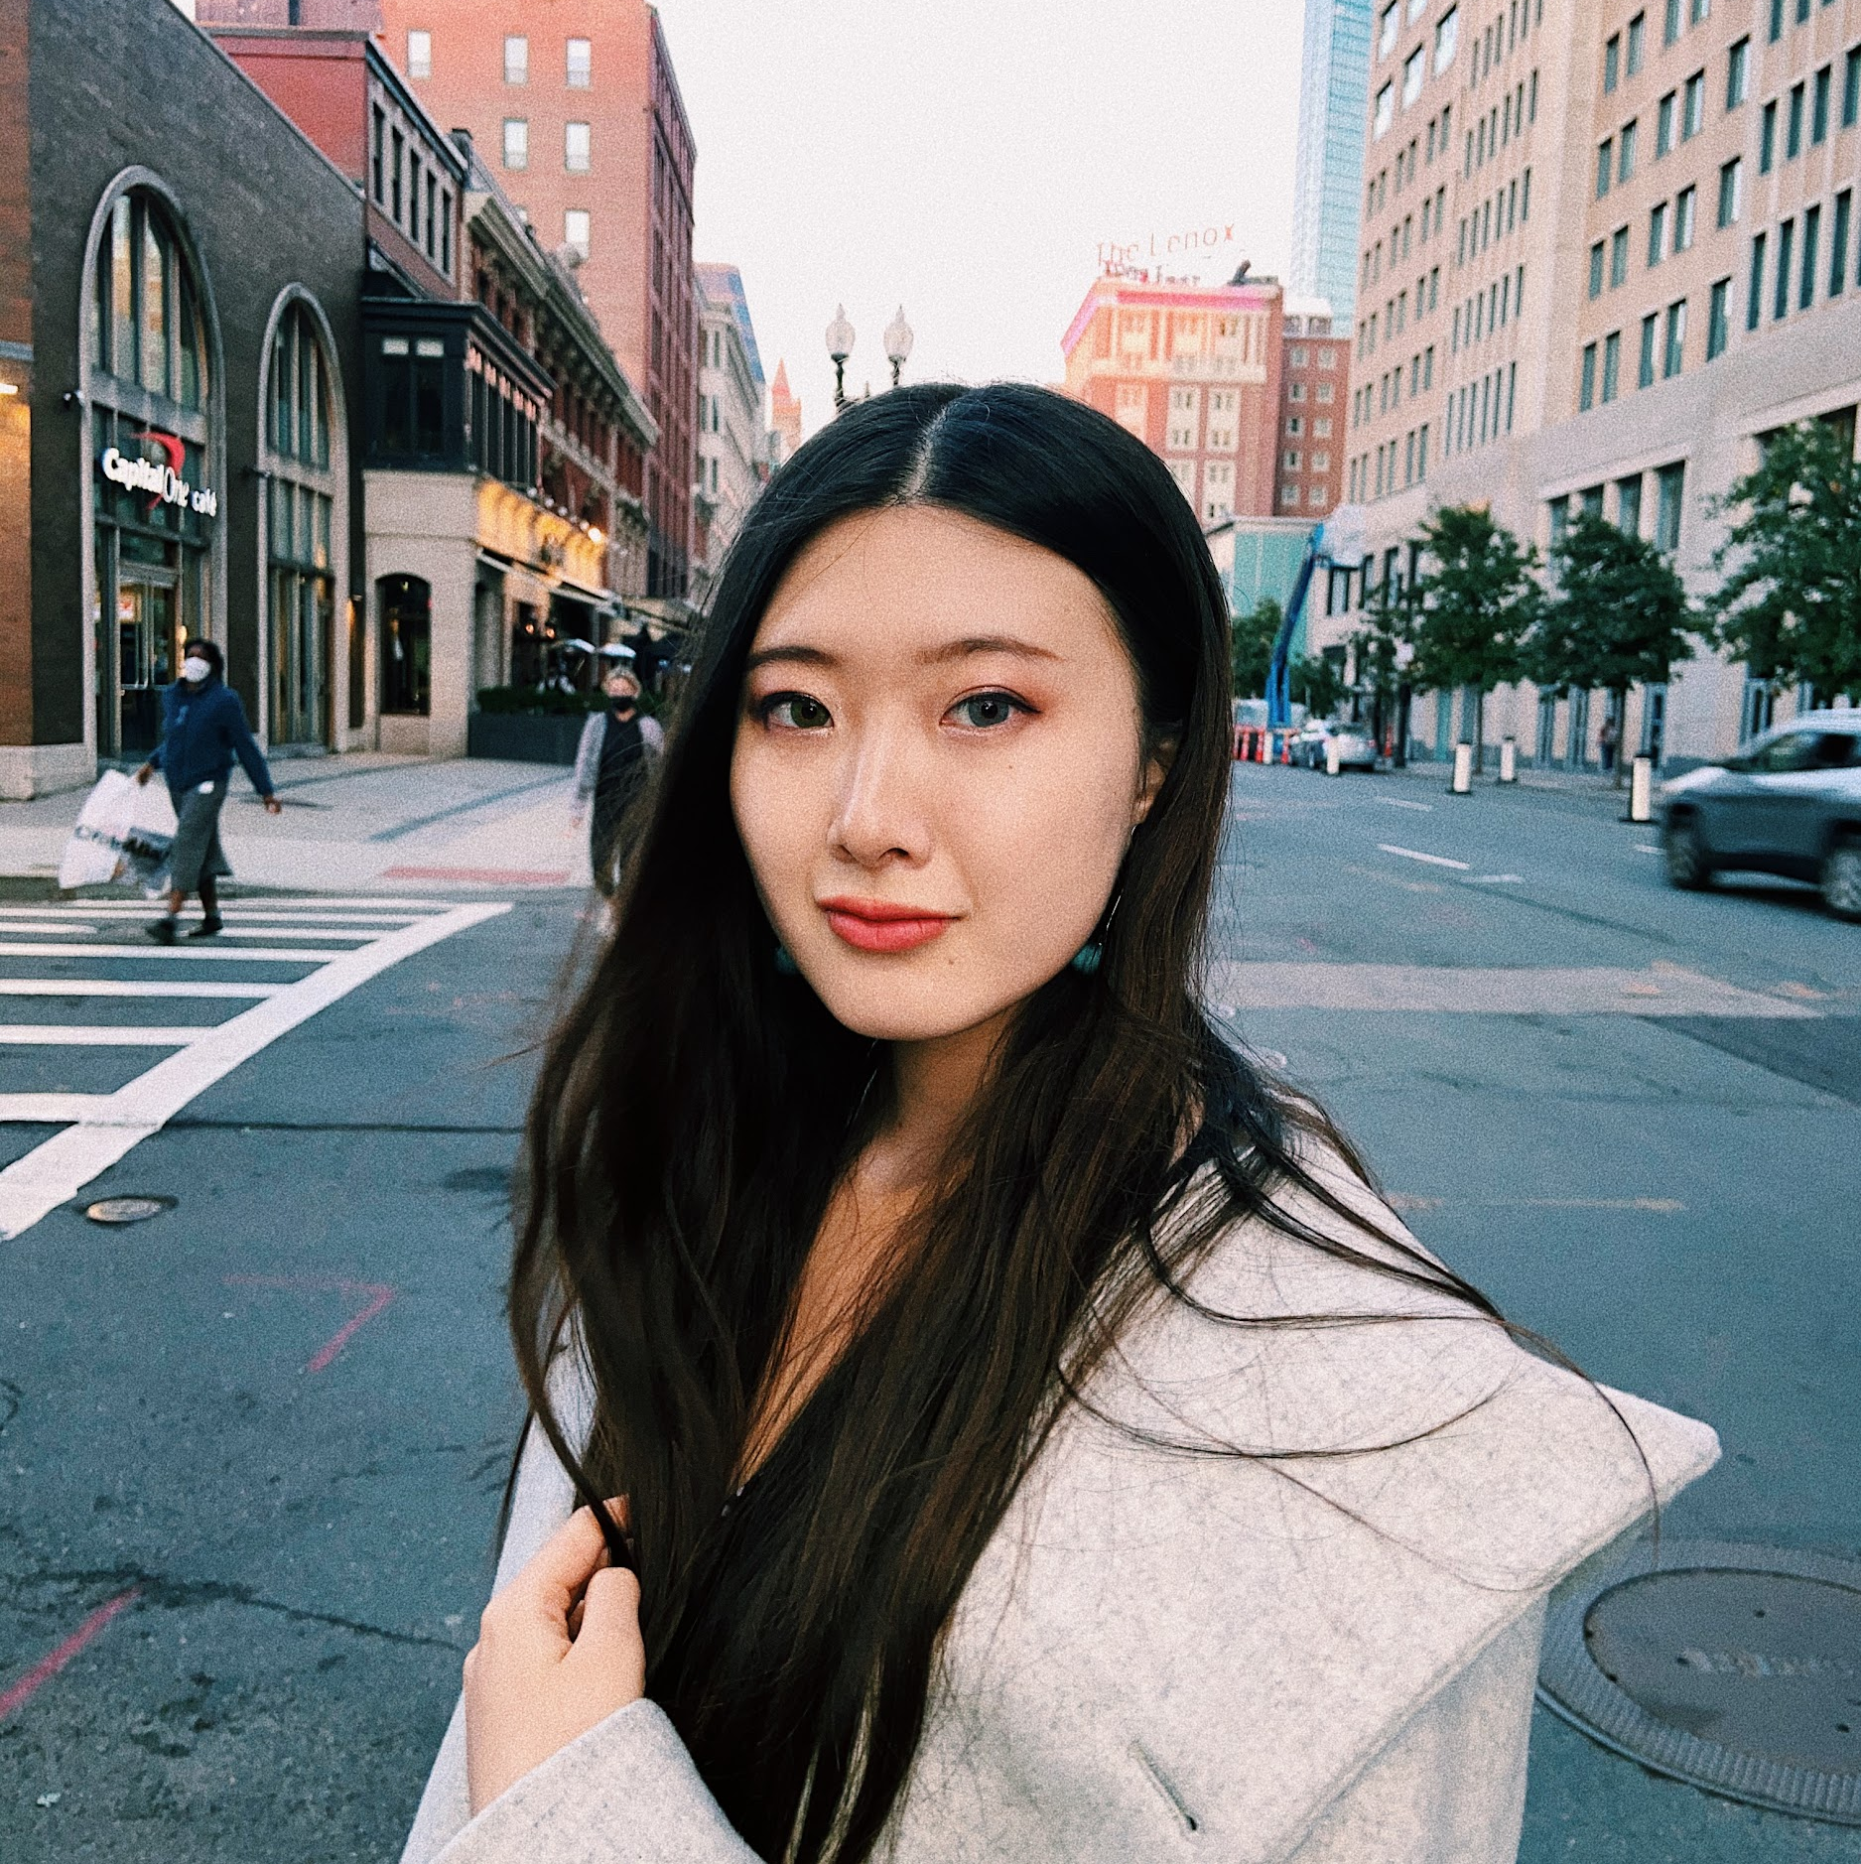
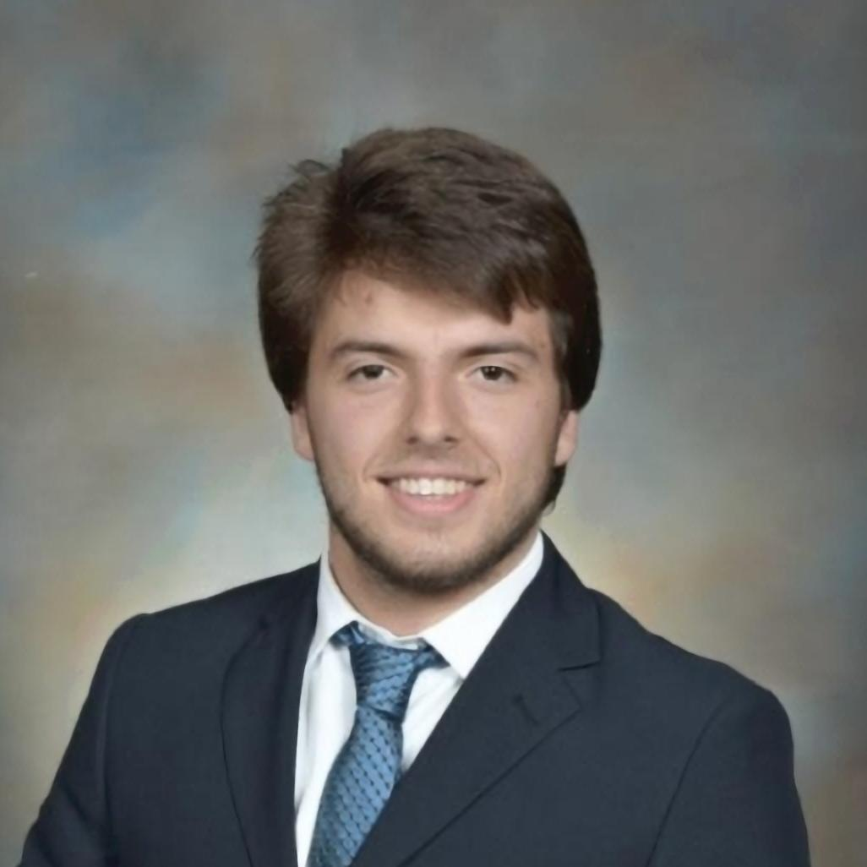
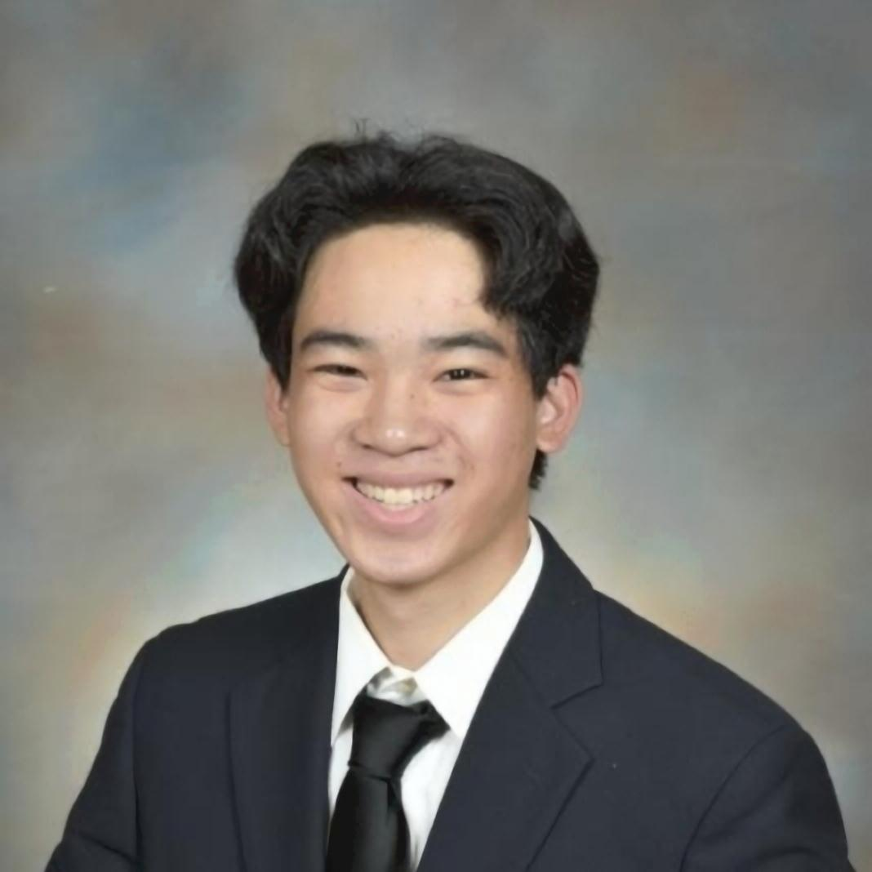
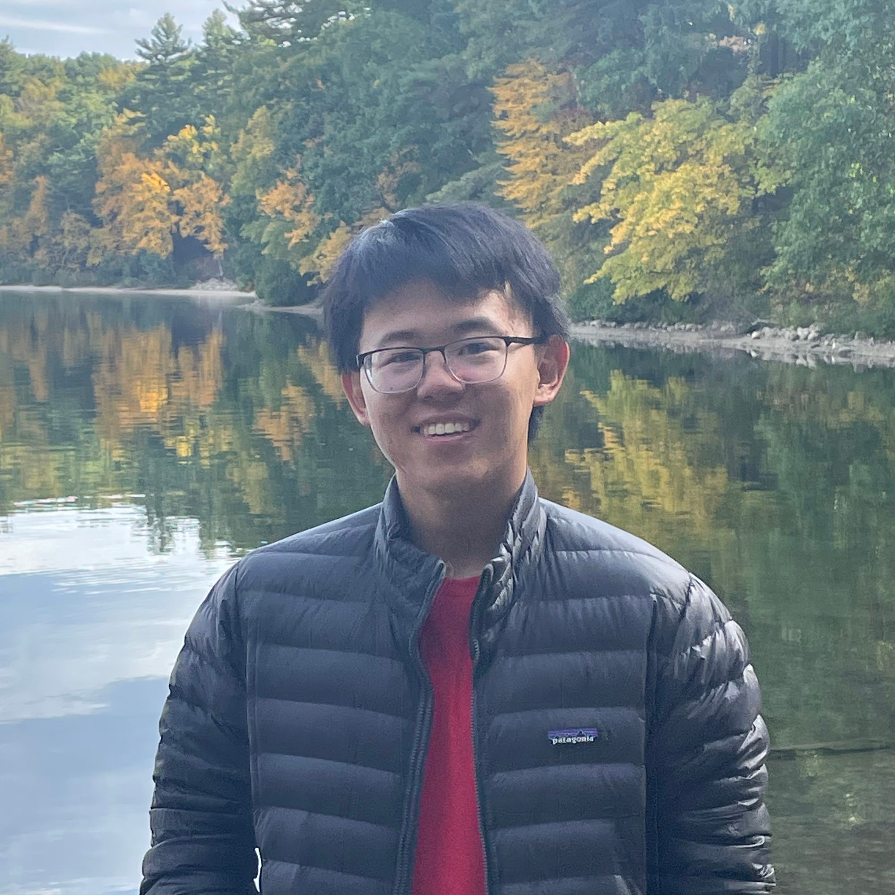
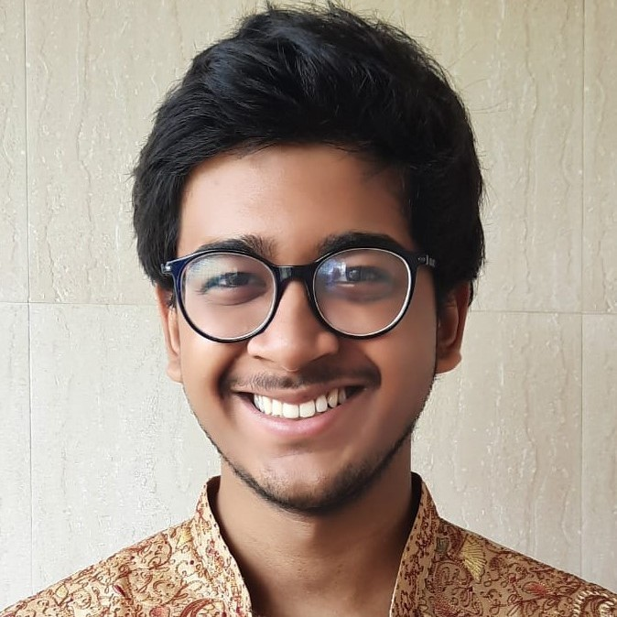
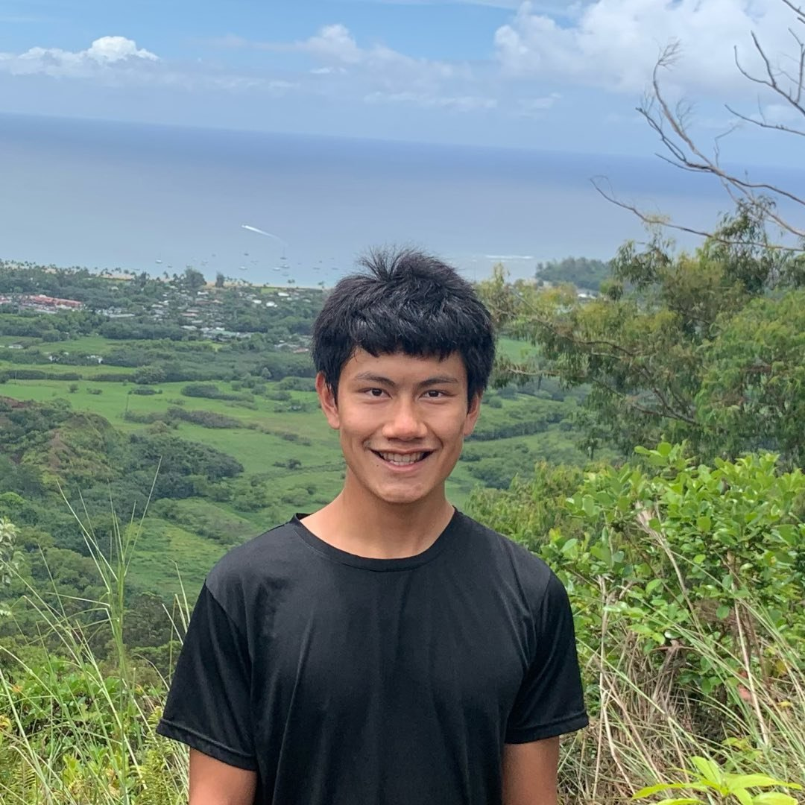
Meet the team
Notes:
Andy
---

Slide 15
See you at Blotto Day!
pokerbots.org
Notes:
Andy
---

